Slide 1
ONLINE QUIZ SYSTEM
ROLL NUMBER | NAME
2310030055 | Pentakota Bhavishya
2310030056 | Munnuru Pravallika
2310030059 | Kotha Sri Harshitha
2310030234 | Uppalapati Yuktha Siri
Quizt!
April - 2025

Slide 2
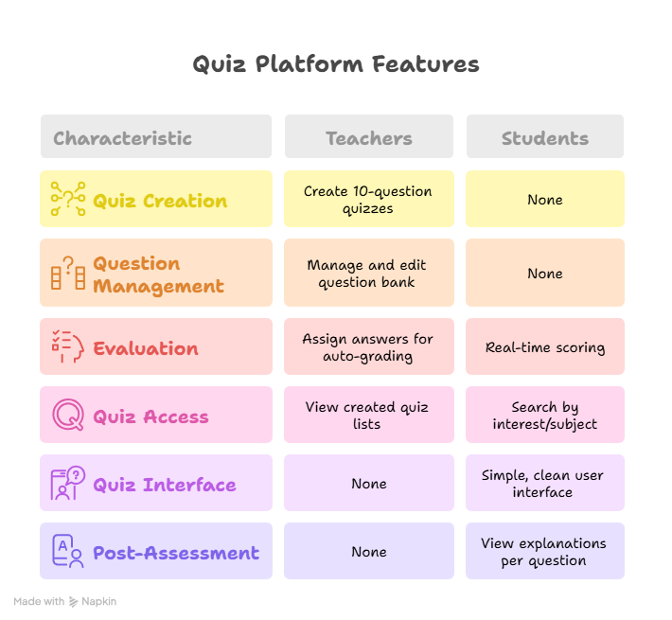
Features for student & teacher roles

Slide 3


Key Features
EDUCATOR
STUDENT
Sign-up
Real-Time Feedback
Participants receive immediate feedback on their answers, which aids in learning and retention. This feature helps users identify strengths and weaknesses quickly.
User-Friendly Interface
The system has a simple and intuitive interface, making it easy for users to navigate and engage with quizzes. This feature enhances user experience significantly.

Slide 4
Feasibility Analysis
The table outlines the feasibility of the online quiz system across several aspects. Each aspect is assessed to help stakeholders make informed decisions.
ASPECT | DETAIL | ASSESSMENT
Technical | Compatibility with devices | High
Economic | Cost of implementation | Moderate
Operational | Ease of use for educators | High
Legal | Compliance with data privacy laws | Critical
Market | Demand for online education tools | High

Slide 5
User Feedback Stats
70%
20%
10%
Neutral Experiences
High User Satisfaction
Dissatisfied Users
70% of users reported being satisfied with the online quiz system.
20% of users felt neutral about their experience with the quizzes.
10% reported dissatisfaction, indicating areas of improvement.

Slide 6
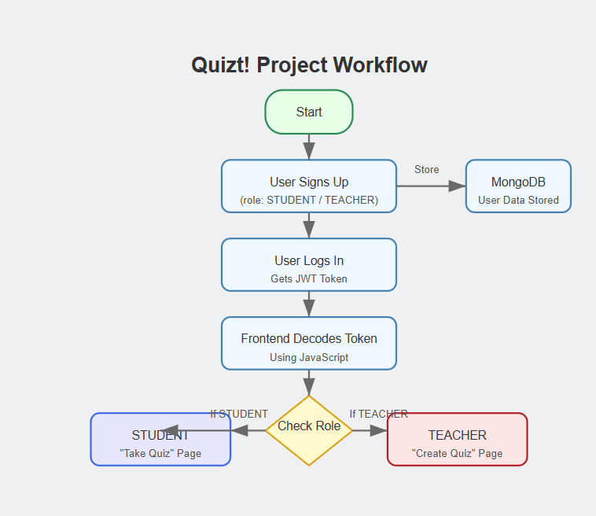
WORKFLOW

Slide 7
Objective of Validation
Why Validate the QUIZT! Model?
To ensure the system works as intended.
To verify the correctness of quizzes, user management, and result calculation.
To detect and fix bugs before deployment.
To ensure security (user authentication and access control).

Slide 8
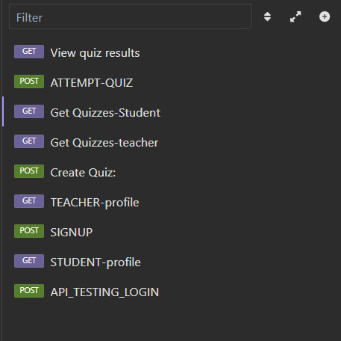
Functional Testing
Teacher Role:
Login/Signup validation.
Quiz creation with 10 questions.
Subject and question storage check.
Student Role:
Search and select quizzes.
Attempt quiz and view results.
Common:
Validation of JWT-based authentication for secured login.
INSOMNIA is used for testing Backend

Slide 9
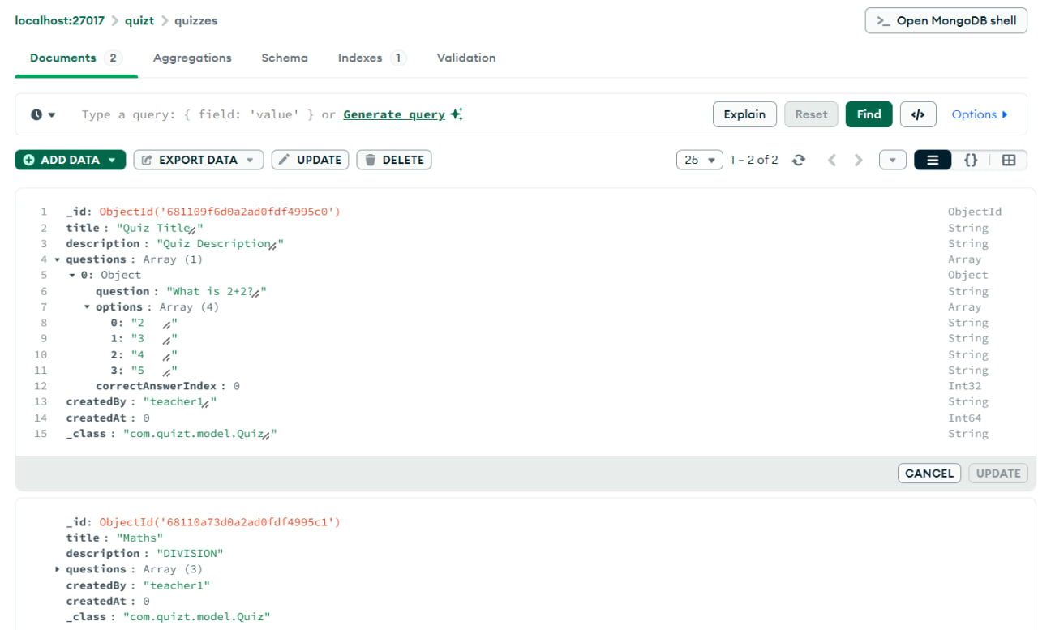
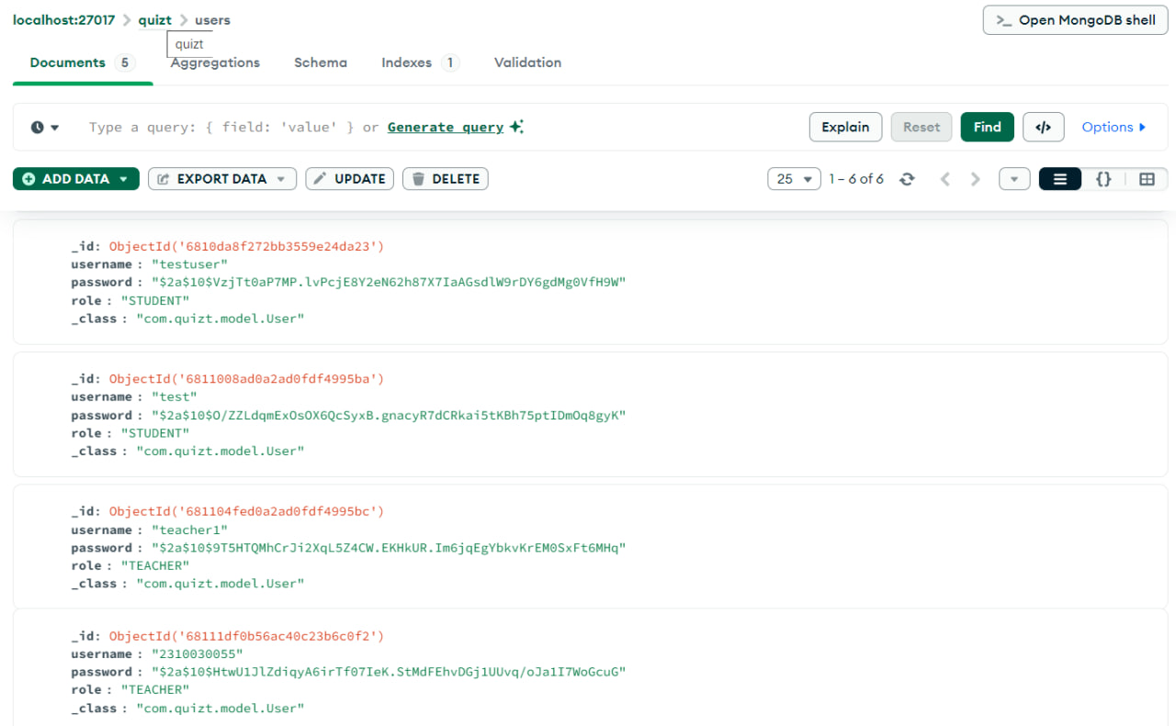
Database Validation
Checking users, quizzes, and questions collections
in MongoDB.
Verifying correct schema structure.
Ensuring quiz results are correctly stored.
Data consistency checked after multiple user actions.

Slide 10
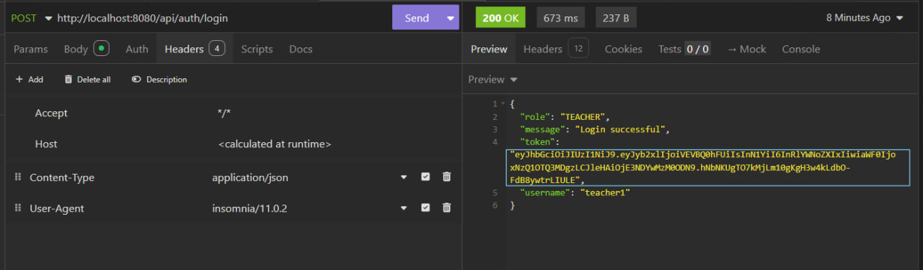
Challenges Faced
Ensuring database does not duplicate entries.
JWT Token expiration and refresh handling.
JWT token

Slide 11


THANK YOU

